Slide 1
One of us?
  The inclusion solution
  Ryan Boughan
  Vice President, Mind Gym Inc.
Notes:
Intro to MG
Recently was talking to an executive that headed up D&I at prof services firm. Thy had just gone through an incredible effort to increase diversity but it had an opposite effect. “Why is it diversity supposed to improve business but it hasn’t with ours”. He realized that for people to succeed in their company you had to speak out in front of large number of people. If good for you – great – got attention and ultimately more opportunities. If not, then there were no opportunities for growth and things slipped away.
Issue was not diversity but how people were felt and received once at the organization. That’s what we want to talk about today – why is it that inclusion is often seen as the Robin to diversity’s batman… when in actuality, it should be the other way around.

Slide 2
Diversity is essential
Diversity
Talent
Reputation
Consumers
Legislation
Innovation
Mobility
Notes:
Now don’t get us wrong, diversity is absolutely essential to business. Macro trends that are going on economically and socially show that organizations have to embrace a diverse culture.
Head of resourcing at major consumer company – more chemists graduating from schools in China than any other country. If you want a great pool of candidates, you have to go there – just one example of needing to bring in the best in the brightest with a different cultural background.
Businesses have found that if we don’t try to connect with our targeted consumers, we are less likely to have them as customers. So lots of things are driving diversity.
This has led to many organizations to increase the diversity of their workforce through corporate policy – having a CDO; having diverse candidate slates etc.
And many organizations have made significant and important progress in increasing the diversity of their workforce. But that, as we learned in the professional services company, is not the full answer.

Slide 3
Diversity without inclusion makes things worse
Employee attachment
Number of
discrimination cases
Revenue
Absenteeism
Worse
Greater
Well-being
Levels of conflict
Number of missed opportunities
Individual performance
Deloitte (2012); Sabharwal (2014); Shapiro, Wells & Saunders (2011); O’Reilly et al. (2014); Jehn et al. (1999)
Notes:
The evidence that mixed gender groups outperform single gender groups came from a Dutch (or Danish??) study where students were randomly assigned into all male, all female and mixed gender groups. They were each given ‘Apprentice’ style challenges (as in the TV program). The mixed gender groups consistently outperformed the single gender groups.
There is also data that shows a positive correlation between share price and having women on the Board.
The lazy assumption was that simply having diversity leads to an improvement in performance.
More robust research looking at diversity in organizations has shown mixed results for performance. Often diverse teams perform worse than homogenous teams.
The data on the slide summarizes the research that shows diversity alone can have negative impact:
For the organization:
Worse revenue, higher levels of missed opportunities (failure to innovate) and discrimination cases.
And for the individual:
Worse individual performance, well-being and attachment and higher levels of conflict and absenteeism.
The explanation for the Dutch student study is that the students were almost certainly displaying inclusive behavior (students tend to in any case and Holland has a liberal/open culture).
Performance of organizations that have women on boards are 26% higher of those that don’t. But what we wanted to look at were studies that looked at both the diversity and inclusion of an organization.

Slide 4
Inclusion delivers commercial gains…
Businesses with high inclusive engagement have an operating profit almost three times higher (27%) than those that don’t.
Greater market share
When employees feel their organizations
are diverse and inclusive, they are…
83% more likely to agree that they
share diverse ideas to develop
innovative solutions
31% more likely to agree that they
meet the needs of their customers
42% more likely to agree that their
team works collaboratively to achieve
their objectives
48%
33%
46%
27%
Improved market share
Captured
a new market
Center for Talent Innovation (2013); Towers Watson (2012); Deloitte (2012).
Notes:
The Centre of Talent Innovation 2013 study of 75 corporations, across 192 countries covering 6 million employees, found that inclusive cultures are 45% more likely to report having improved market share in the last 12 months. And 70% more likely to have captured a new market. Now this makes sense – if you’re looking to enter a new market or increase your market share, it probably makes sense that having employees that mirror those new markets are going to attract new business. But what if you’re an organization that isn’t looking to enter a new market?
The Corporate Executive board Global Labor Market survey of 18,500 employees found that where difference and inclusion co-exist:
Employees are 19% more likely to stay than employees where they don’t
12% more likely to expend discretionary effort.
Another study by Towers Watson published research on 50 companies showing that those with high inclusive engagement had an operating profit almost three times higher than those that don’t (27%).

Slide 5
Inclusion linked to personal performance
Source: Deloitte (2013). Waiter, is there inclusion in my soup? Research report.
Notes:
Not only that, there is a direct link between employees that that feel included and their individual performance raitings.
So the business case for not only diversity but also inclusion is very compelling. So how do we go about doing this as organizations? First, we need to take a look at the myths that are pervasive throughout organizations when it comes to building this culture.

Slide 6
Hand in hand
Corporate policy can deliver diversity, but inclusion is delivered through individuals
Diversity
Leadership accountability
for diversity (supported with metrics)
Flexible working arrangements
Diverse candidate slates
Mentoring programs for
minority groups
Employee resource groups
Chief Diversity officer
Corporate policy
Inclusion
Managers and individuals who:
Increasingly spot their bias and check it
Are curious about different views, insights and ways of being
Alter their behavior to make it easier for different people to be accepted and flourish
Personal activity

Slide 7
Inclusion goes beyond diversity
Diversity 3.0
Inclusion embedded
  Everyone feels psychologically safe.
  People are curious about different views, insights and ways of being.
  People alter their behavior to make it
  easier for different people to be accepted
  and flourish.
  Inclusive behaviors become a ‘way of being’.
Diversity 2.0
Marketing
  People look to be inclusive and equitable ‘because they have to’.
  There’s a lot of talk about D&I, but people aren’t sure of what it means or how to talk about the real issues.
  Unconscious bias training.
Diversity 101
Compliance
  Leadership accountability for diversity (supported with metrics).
  Flexible working arrangements.
  Diverse candidate slates.
  Mentoring programs for minority groups.
  Legal training.
Frost, 2015
Notes:
So what is the business case for inclusion? We’ve talked a bit about how diversity without inclusion can make matters worse, but does an inclusive culture actually make things better? And unsurprisingly, the answer is yes.
101 – this is important
2.0 – UB exists

Slide 8

Where can inclusion go wrong?
Notes:
So now that we’ve touched on the business case for performance – I wanted to hit on where our best efforts to be inclusive can go wrong.
So many times we talk about ‘inclusion’ as this holy grail of solving our organizational challenges. But when done wrong it can be harmful to our day to day. So let’s brake into groups

Slide 9

Death by over-collaboration
Decisions go round… and round… and round.
Notes:
Where can it go wrong – talk about inclusion as it can only be a good thing?
People confuse inclusion and involvement – end up involving a bunch of people that then feel excluded because they didn’t agree with the end decision.

Slide 10

Avoiding
Faking it with tokenism
They’re not really being listened to.
Notes:
We set up all these different groups at organizations – women’s leadership, LGBT groups, various minority groups. But what do we actually do with their input? How do we involve them in the organization’s goals or direction? Or do we just view them as places where they can go to discuss what it’s like to be in a minority group at this company?
Planet of the apes – Charlton heston

Slide 11

Chasing consensus
Agreement is favored over quality.
Notes:
Sometimes a culture of consensus is mistaken for a culture of inclusivity. One where we try to make sure everyone and their mother gets to share their opinion on a direction all the time.
Hand and hand with a meritocracy – they aren’t either or, they are ands.
Designing for the outlier

Slide 12

One rule for some, one rule for others
Standards bend for special cases.
Notes:
We see this a lot in sales or creative functions. The high performer or loan wolf has a certain type of behavior that we ignore because it is beneficial for the business. If any of you watched Mad Men I’m sure you’d agree that Dom Draper wasn’t the most inclusive person in the world…
So how can our leaders help

Slide 13

Inclusive leadership
Uniqueness
Belongingness
…helping people feel able and safe to be their authentic self.
…helping people feel that they are a valued member of the team.
© Mind Gym
Notes:
So why is this responsibility on leaders to set the tone.

Slide 14

Covering at work
What percentage of people report that they don’t feel comfortable or safe being themselves at work?
© Mind Gym
Notes:
EXERCISE
A recent study by Deloittes looked into the degree to which people cover a work. Ie don’t feel comfortable being themselves at work:
Stand up if you think it is 5% or more
Keep standing if you think it is 20% or more
Keep standing if you think it is 50% or more?

Slide 15
Bend out of shape
83%
79%
66%
61%
…of employees bend themselves out of shape to fit in at work
…of LGB individuals
…of black individuals
…of women
63%
45%
…of Hispanic individuals
…of straight white men
Yoshino and Smith (2013).
Notes:
Key point
A study by Deloitte showed that at an individual level, a high number of us are bending ourselves out of shape to fit in. Researchers Yoshino & Smith showed up to 61% of respondents felt they were ‘covering’ in some way (Yoshino and Smith 2013).
The challenge is that you can’t tell from the outside how someone is feeling on the inside. And this isn’t the preserve of minorities: 45% of straight white men responded that they ‘covered’. We hear it when people say:
“I’m not in the in-group/”I feel like I am just a corporate suit”
“I don’t feel I belong”/“I can’t be myself”/ “I’m not part of the club”
It’s symptomatic of the challenges of integrating a diverse workforce.
The main reason given in the research for this was despite money and effort being spent on ‘participation’ exercises – forcing people to join in/team build without working hard to integrate and assimilate the differences beforehand – i.e. without really getting to know people for who they are and the strengths they bring.
We all know the feeling of having to force a smile at a time we don’t want to – it doesn’t feel great.

Slide 16
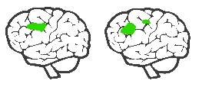
Bending out of shape is not only bad for business…people suffer
=
Psychological pain of
feeling excluded
Physical pain
Eisenberger, Lieberman & Williams (2003); Cikara & Fiske (2011).
Notes:
Key point
If people bend themselves out of shape, isn’t just bad for business, it’s also bad for well-being.
When we feel excluded it affects the same part of the brain as physical pain [the dorsal anterior cingulate cortex]. It hurts. Exclusion is the only psychological experience that does this. This, in turn, affects sleep, stress, illness and more. By excluding people we are damaging their health as well as their well-being.
This is a primary reason why the Canadian government has made companies legally responsible for their employees psychological as well as their physical safety.
Kids feel this when it comes to picking teams in school…

Slide 17
The key to inclusion: value difference
Race
Religion
Family status
Education
Accent
Age
“I am not different from you,
I am different like you.”
Dr. Laraine Kaminsky
Outlook
Interest
Job
Disability
Humor
Me
Energy
Dress sense
Gender
Politics
Values
Sexuality
Appearance
Manners
Height
Notes:
Our way into ‘inclusion’ is to focus on how we respond to difference, in whatever form it takes, and to increase the chance that we will welcome and cherish it. There are very clear personal benefits for people who do this well so the ‘appeal to self-interest’ is stronger and the chances of changing habits far greater.
By avoiding a focus on the big six differences, by talking about difference in an infinite capacity and in scientific language, we can bypass a lot of emotive areas that are traditional barriers to effectively informing and equipping a workforce to be inclusive.
Our view on differences is that it is infinite. Historically there are differences that have led to stronger reactions between people - and that is still the case today. But reactions can equally be triggered by any number of smaller differences, including differences like weak handshakes.
Our view on similarities is the same as differences: it is infinite. And research supports the power of similarities at any level. People who were told they shared a birthday with Rasputin rated his deeds far more leniently than a control group. We are 270% more likely to give to a hurricane relief fund if the name of the hurricane starts with the same letter as our name. And so on….
Malcom Gladwell talks about how sizeism will be the new cause of discrimination moving forward

Slide 18




We create an inclusive culture when...
Everyone across the company works hard to
Appreciate people for who they are, especially when they are different from ‘me’
Make fair decisions about people
Psychological safety
Build connections between people who might otherwise see themselves as separate
Notes:
Key point
In summary, three practical areas where we can choose to think and behave in ways that increase inclusion are:
Appreciate people for who they are, especially when they are different from us, by relishing what we don’t have in common with other people as much as what we do
Make fairer decisions about people, for example by mitigating our own prejudices, which are often shorthand rules that we’ve picked up but, even if they were once valid, no longer are (e.g. superstitions, old wives’ tales)
Build connections between people who might otherwise see themselves as separate, or at least avoiding making unnecessary disconnections that people interpret in ways that lead to them feeling excluded.
This delivers psychological safety = when people feel that they can be themselves at work. An inclusive culture is one where people feel psychologically safe (and vice versa).
Questions
To what extent do you feel you have psychologically safety/an inclusive culture?
How do you measure it?
Link
So how do these three link together to create inclusion?

Slide 19
Creating psychological safety
How often have… | rarely | sometimes | often
People told you they have made a mistake?
You learned something about someone that surprised you?
You publically praised a direct report (or someone more junior) for expressing a contrasting point of view to yours?
People shared information with you which they definitely do not want to be shared any further?
People thanked you for understanding them?

Slide 20
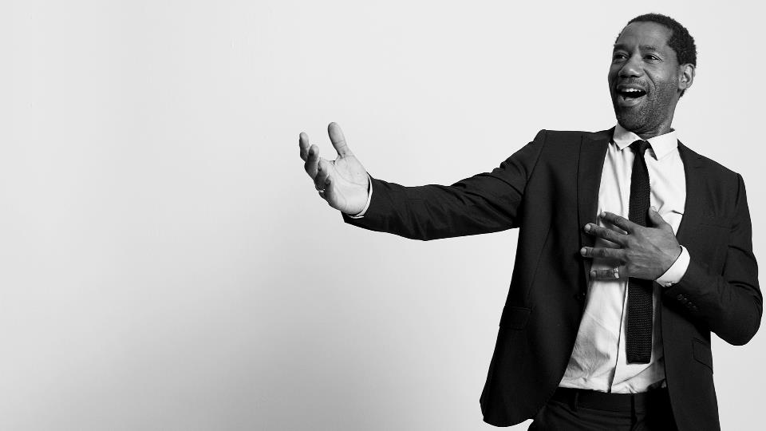
Where ‘unconscious bias’ fits
The facts:
We are all susceptible to unconscious biases
The effects are very significant
Unconscious biases are notoriously
difficult to change
The most proven tool to mitigate
unconscious bias is ‘counter-stereotyping’
This is difficult to apply in a corporate environment (though we do give it a go)
Lai et al. (2014).
Notes:
Two economists, Professors Goldin & Rouse, studied the auditioning process of eight major orchestras over the space of 30 years. They did this to see the difference made by the introduction of blind screening in this process. Blind screening is where an audition is held in which information about the candidate that might lead to bias in the results is concealed from the tester. In this case, Professors Goldin and Rouse specifically analyzed the genders of auditioners before and after blind screening was introduced, and found it increased female participation in orchestras by 30%.
‘Unconscious bias’, using tools like the IAT (Implicit Association Test), is certainly interesting and worth knowing, but it is notoriously hard to change.
A research article by 22 authors (Lai et al., 2014), spanning various universities including Harvard, investigated 17 different interventions that looked to reduce unconscious bias. Only 8 interventions were particularly effective, and of those only 5 are practical. Even these 5 are not behaviors that we can practise on a daily basis, but cognitive tactics we can use to nudge our brain. Practising these will help us reduce prejudice, but to really influence inclusion, we should focus on improving psychological safety through valuing difference and being inclusive.
‘Counter-stereotyping’ is when you acknowledge a bias that you want to change. You then look at counter examples. For example, if you are more likely to associate negative attributes to people of color, then you look at pictures or watch short films about successful people of color (say, Oprah, Obama, Martin Luther King, etc.). Your bias will become less afterwards. It’s very difficult to do in a corporate environment as people have to admit to the bias (‘I am racist/sexist’) and openly want to change it. We give it a go encouraging participants to think, for example, about the stereotypes and counter-stereotypes of students, which at least introduces them to the technique so they could choose to apply it on more serious biases in the privacy of their own minds.

Slide 21
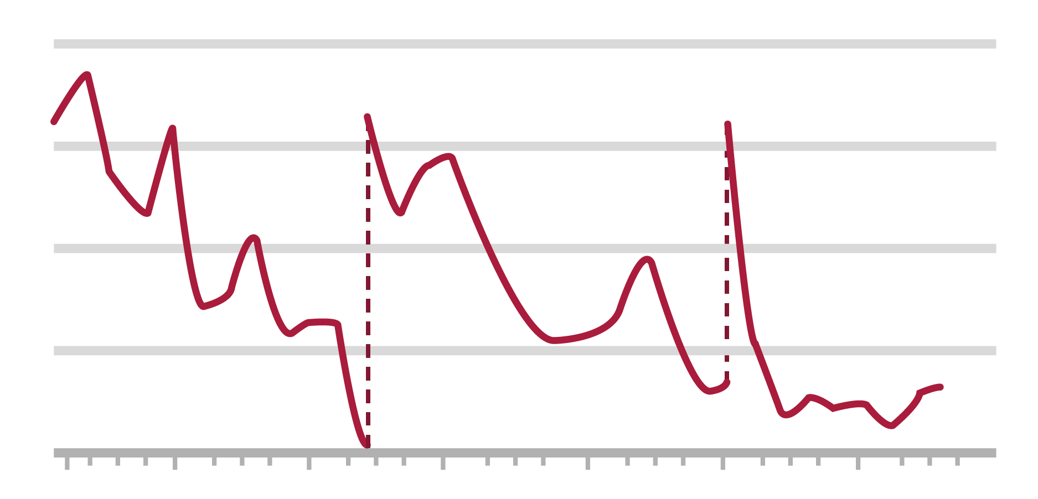
Justice for all?
1,100 judicial rulings made by eight parole judges
80
60
Favorable rulings by parole boards %
40
20
Meal break
Meal break
1
5
10
15
20
25
30
Number of cases heard that day
Source: Danziger et al. (2011) Extraneous factors in judicial decisions PNAS, April 26.2011, vol. 108

Slide 22
Warmth and competence
Warm
Collaborative
Competent
High status
Cold
Competitive
Incompetent
Low status
Notes:
Sterotype content model – Susan Fiske
Many organizations have started to look at UB bu
Can’t tap into UB, can’t anticipate it
How can we recognize those moments – use our emotion
What types of emotions might we feel when we interact with others and how can use those as a trigger
When you think about people interacting – dimentionalize it in two ways warm/cold comp/incomp
What’s very interesting – warm/comp

Slide 23
Who do we react this way to?
Competent
Admiration
Resentment
Warm
Cold
Pity
Contempt
Incompetent

Slide 24
What this reaction shows up as…
Competent
Admiration
Resentment
Leads to favoring
Leads to hindering
Warm
Cold
Pity
Contempt
Leads to helping
Leads to discriminating
Incompetent
Notes:
That’s as much bias behavior as contempt and pity – doesn’t mean we’re emotionally react
I feel warm to them because they are emotionally cold like me, highly

Slide 25
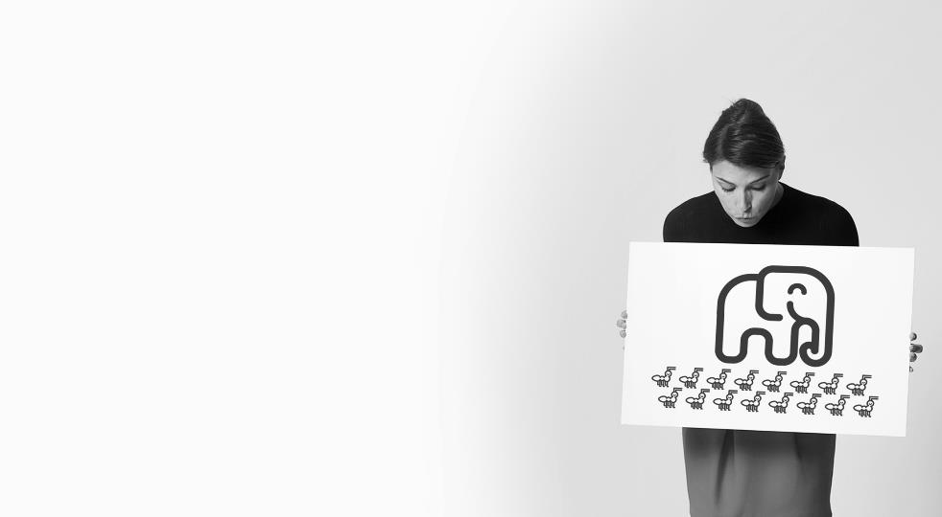

How microaggressions can erode your culture
Sarah recalled her mentor’s advice about networking, so when she was at a company event and saw her colleagues talking to the vice-president, she walked over to introduce herself. The VP responded, “thanks, I’ll take another white wine please.” Sarah was stunned as she realized the VP had mistaken her for a waitress and her colleagues hadn’t said anything.
Notes:
Steven Young – was CDO for JP Morgan but has now gone on to be one of the leading thinkers in the inclusion space, talks about how organizations tend to manage the elephants while the ants walk by. The elephants being the policies we have in place and the ants being the microaggressions we see every day in organizations – focusing the attention on what happens on a day to day level.

Slide 26
Inclusive behaviors
Value
Bridge
Protect
Acknowledge someone for who they really are and make them feel appreciated for it
Bring people together when their differences are pulling them apart
Step in to support people when they’re at risk of being excluded
Notes:
How do you move from being a bystander to inclusion to actually bringing people in and being proactive about it?
A skill we like to talk about here is pivoting – so going back to the previous example

Slide 27
Making change stick
Engage
Get excited about
what there is
to discover
Participate
Discover new tools
and techniques, often
in a bite-sized workshop
The most effective solutions consist of a continuous cycle of discovery with three stages.
Activate
Try out new discoveries
and report on
what happened

Slide 28

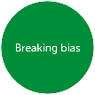


Participate: Putting the bite into bitesize
New products designed specifically to build inclusion (all with engagement and activation tools):
2 Go larges
3 Workouts
Half day event immersion session
Awareness
Behavior
Appreciate people
Fairer decisions
Make connections
Leading
inclusivity
One of us
The inclusion
ingredient
Notes:
Key point
Mind Gym has developed four new products specifically targeted at building inclusion. However, there are other Mind Gym products that will also help.
The new products are three workouts:
Knowing me, knowing you. This workout looks at our own personal ‘trigger’ differences and how we can do more to control our responses. Also, how to spot and cherish differences in others.
Breaking bias. This workout looks at how we use mental shortcuts to make decisions about people, when these can do more harm than good and how to audit and, where necessary, rewrite them.
Building bridges. This workout looks at how we value, protect and bring into decisions/conversations people who might otherwise feel left out, as well as what to do when we spot others behaving in a way that isn’t inclusive.
And a go large
One of us. This builds awareness about the degree to which we exclude others (including unconscious bias) and why it matters for the companies we work in, the colleagues we work with and, most important of all, our chances of living happy and fulfilling lives.

Slide 29
One of us?
  The inclusion solution
  Ryan Boughan
  Vice President, Mind Gym Inc.
Notes:
Key Point
There is clear demand from progressive clients to talk about diversity and inclusion. Many have been on a 30-year journey; others are taking early steps. But all are very focused on moving beyond corporate policy and compliance into cultural change.
Our workouts are not a substitute for compliance training but instead focus on how to build an inclusive culture to reap the benefits of a diverse workforce.
Questions
Have you got/done compliance training for D&I (the tick box stuff) that avoids/minimizes accusations of discrimination etc?
To what extent are you really focusing now on cultural change in order to leverage the benefits that a diverse workforce can bring?
Link
Why has D&I risen up the corporate agenda?

